Slide 1
Portuguese Bank Telemarketing dataset
Project-Exploratory Data Analysis
By - Snehika Pandey

Slide 2

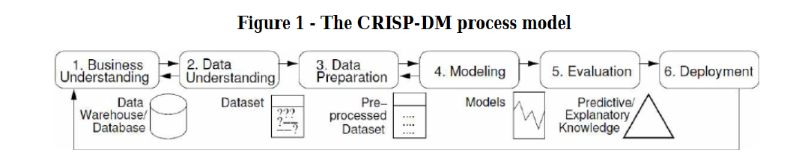
About Project
Indirect Marketing and Direct Marketing
Portuguese Bank do Direct Marketing through telemarketing.
Project is to analyze effectiveness of the telemarketing campaigns to sell long term deposits.

Slide 3
Introduction
About Dataset – Dataset has been mined for Direct Bank Marketing
Created by: Paulo Cortez (Univ. Minho, Portugual) and Sérgio Moro (ISCTE-IUL, Lisbon(Portugal)) in 2012
Data is Available at http://hdl.handle.net/1822/14838 http://www3.dsi.uminho.pt/pcortez/bib/2011-esm-1.txt
Dataset is publicly available for research

Slide 4

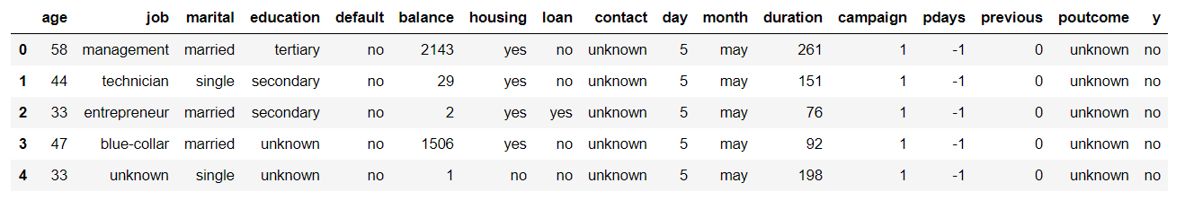
Motivation/Dataset Background
Dataset was created to as a part of campaign of Portuguese Banking Institution.
Aim was to predict if the product will be purchased by the customer.
The marketing campaigns were based on phone calls. Often, more than one contact to the same client was required.
Human Agent were used for data agglomeration

Slide 5
About Dataset
There are two datasets: {bank-full.csv with all examples, and bank.csv with 10% of the examples (4521), randomly selected from bank-full.csv}
Number of Instances: 45211 for bank-full.csv (4521 for bank.csv)
Number of Attributes: 18 and output attribute
Attribute Types – 10 Numeric and 8 Categorical
No missing value in the Dataset

Slide 6
Univariate/bivariate Variable Analysis
Age – Box Plot(From the box plot we observe that almost 97%-99% are aged below 70 and the max age is 95)
Job – Countplot (We observed frequency of various job types and observed that student and retired customer has highest numbers)
Marital Details – Countplot (Observed highest frequency number was of Married, single and divorced)
Education – Countplot (showcased most of the customer passed secondary education)

Slide 7
Univariate/Bivariate Graphical Analysis
8
Default – Countplot (From the subscription percentages there is a higher chance of subscription if the people have default status as No).
Balance with Target Attribute – (We can relate that with the decrease in balance subscription decreases).
Loan with Target Variable - Customers with No loan are subscribed more almost double to that of people with loan
Contact Type with Target Variable - Most people reacted Positively for cellular and mobile than any other types of communication

Slide 8
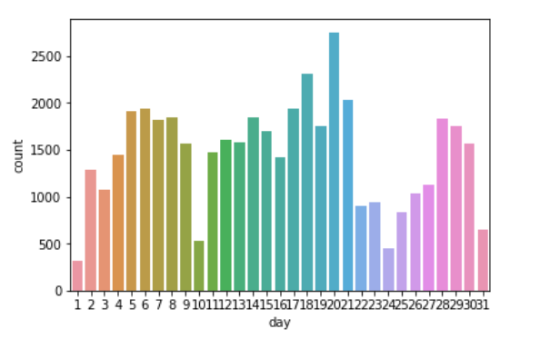
Univariate/Bivariate Graphical Analysis
Day of Contact - from the above graphical data we can conclude that most people are contacted on 20th day followed by 18th and least is on 1st date

Slide 9
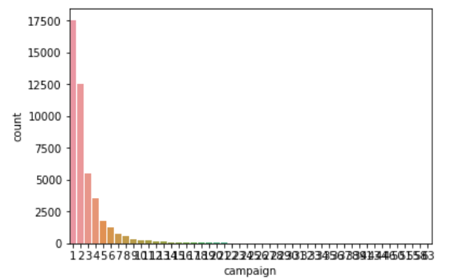
Univariate/Bivariate Graphical Analysis
Month of Contact - Most successful month is being May ,July, August, November.
Campaign – No of times people were contacted during this campaign was only once

Slide 10
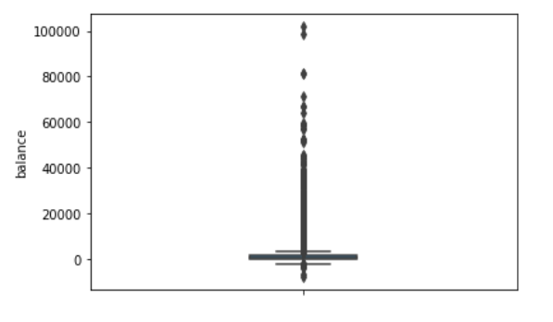
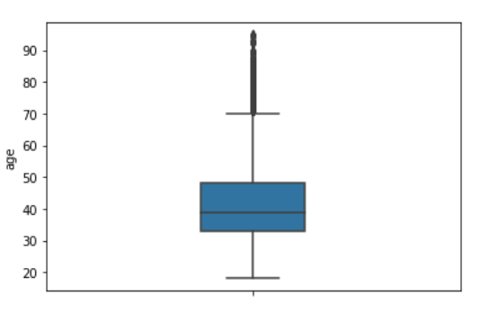
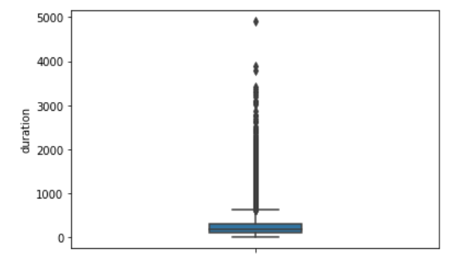
OUTLIER
Age, Balance and Duration Variable tend to have a lot of outlier.
Interquartile Range used for outlier treatment

Slide 11
Predictive Modelling
Our aim was to predict the plans that can be sold via telemarketing.
Problem Type- Classification Problem
Machine Learning Algorithm used – Naïve Bayes, Decision Trees, Support Vector Machine
To check the performance across various algorithm

Slide 12
Performance
Naïve Bayes performed better than Decision Trees and SVM
Number of output were more than one i.e. if we limit the number of labels we can observe different results

Slide 13
Thank-You

